Slide 1
A10:2017- Insufficient Logging & Monitoring
Seán Grant - 15347791
Brian Emmett - 15352991

Slide 2

Overview
Introduction to what defines insufficient logging.
OWASP rating.
Attack Scenarios and Vectors including real world examples.
Mitigations and Remedies.
Conclusions.

Slide 3
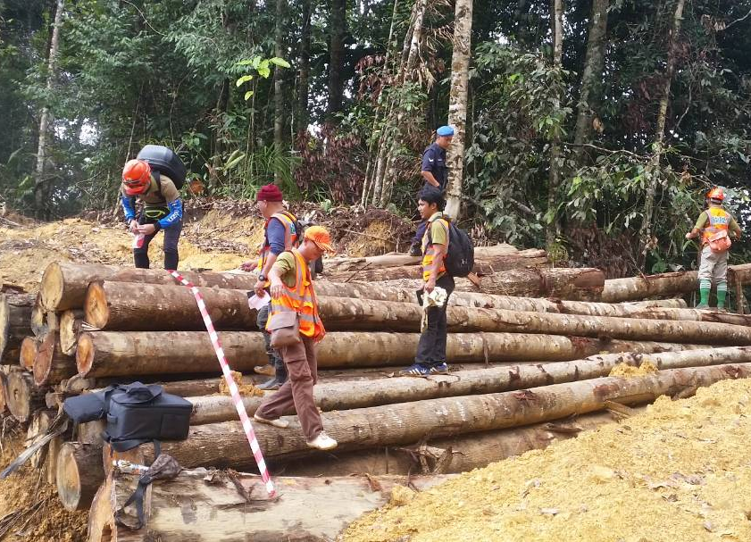
What is Logging?
Logging: Process of documenting and tracking events within an application (e.g. User logins, modifications, data access).
Large files of generally useless data, but acts as a record in the event of an attack.

Slide 4

What is Monitoring?
Monitoring: Viewing and reacting to these events in real time, and dealing with abnormal and unexpected events.
Can be automated or manually performed.
Machine Learning used to identify anomalies.

Slide 5
Why is this important?
“Exploitation of insufficient logging and monitoring is the bedrock of nearly every major incident.”
Logging creates a record of what events are occurring within the system, allowing the ability to track an attackers actions, and respond in a timely manner.
Online Trust Authority in their 2018 report that 78% of attacks could have been mitigated and prevented with improved logging and monitoring practices.
Not only an issue for Web Apps, but affects entire IT sector.

Slide 6
Why is this important?
“Attackers rely on the lack of monitoring and timely response to achieve their goals without being detected.”
Monitoring indirectly acts as a mitigation of damages of other attacks.
Anomolies in activity will trigger these monitors, which will recognise malicious or probing behaviour.
The detection of an attacker’s probing of the systems will alert the relevant parties, and allow them the opportunity to prevent an attack before it occurs.

Slide 7
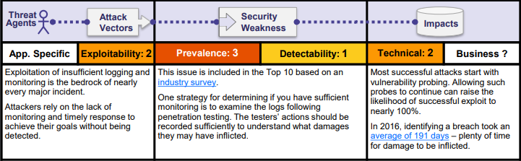
OWASP Rating

Slide 8
OWASP Rating
The basis of almost all major attacks
Greatly impacts detection and response time
Notes:
Exploitation of insufficient logging and monitoring is the basis of nearly all major attacks
Lack of it greatly impacts detection and response time

Slide 9
OWASP Rating
Part of OWASP Top 10 based on industry survey rather than quantifiable data
Unclear how many systems are impacted

Slide 10
OWASP Rating
Most successful attacks start with probing
Proper logging and monitoring could identify attacks before they even happen
An average of 191 days to identify a breach

Slide 11
Identifying Insufficient Logging
Have a penetration tester probe your web app. If you cannot subsequently identify what was performed then logging is inadequate
Error and warnings generate inadequate or no messages.
Alternatively, another instance of insufficient logging takes the form of actively logging and displaying error messages/logs to the user, creating information leakage and violating A3- Sensitive Data Exposure.
Events that can and should be logged, are not (Logins etc.)

Slide 12
Identifying Insufficient Monitoring
“Logging and monitoring go hand in hand. There is little point in having adequate logs if they are not adequately monitored. “
Logs are only stored locally.
Appropriate alerting thresholds and response escalation processes are not in place or effective.
Penetration testing and scans by DAST tools (such as OWASP ZAP) do not trigger alerts.
The application is unable to detect, escalate, or alert for active attacks in real time or near real time.
Logs of applications and APIs are not monitored for suspicious activity.

Slide 13
Attack Scenarios
Insufficient logging and monitoring is too abstract to be a direct attack vector
Impacts the detection and response to every single breach
With insufficient or badly stored logs, security risks can go unaddressed
With improper monitoring suspicious activity can easily be missed

Slide 14
Example 1: stealing data
Attacker is downloading large amounts of data from the server
Proper logging and monitoring will detect the abnormally large amounts of outgoing network traffic
Once this is detected it is then easier to prevent such a breach in future

Slide 15
Example 2: Bitcoin miner
If an attacker were to have installed a cryptocurrency miner on the server then CPU load would drastically increase
This could result in the company paying an overly large amount of money for server rental
Again by logging and monitoring the CPU load on the server such breaches can be detected and prevented

Slide 16
Fileless Attacks
Example of a more sophisticated attack that is harder to detect
Specifically designed to be stealthy and not trigger alerts from installed logging and monitoring software
Does not drop any malicious files onto hard drives – meaning there is no file to be detected
Fileless attacks are ten times more likely to succeed than file-based attacks
Ponemon Institute reports that 35% of attacks were fileless in 2018

Slide 17
A10 In REality
Insufficient logging and monitoring is an extremely common issue that is related to any attacks that occur
Particularly comes to light when the affected company is unable to detect or diagnose an incident
When a data breach is made public, it is impossible to say whether the company has been aware of it for a while or just recently discovered it

Slide 18

REAL-WORLD EXAMPLE: YAHOO
In September 2016 reported a breach from 2014 affecting 500 million users
Again in December 2016, reported another breach, this time from August 2013, affecting over a billion users
Later reported that this breach actually exposed every single Yahoo account that existed at that time, over 3 billion users
Both breaches took 2-3 years to be reported, a clear indicator of insufficient logging and monitoring being performed by Yahoo
Notes:
At the time were the two largest incidents ever to occur in terms of the number of accounts affected
Mention gdpr idiot

Slide 19
Mitigations and Remedies
Ensure all login, access control failures, and server-side input validation failures can be logged with sufficient user context
Ensure that logs are generated in a format that can be easily consumed by a centralized log management solutions.
Establish effective monitoring and alerting of suspicious activity
Establish or adopt an incident response and recovery plan, such as NIST 800-61 rev 2 or later
Notes:
1. Helps identify suspicious or malicious accounts
3. Ensures suspicious activity is detected and reported in a timely fashion
4. Which is a Computer Security Incident Handling Guide

Slide 20
Maintaining Integrity of Log files
Build in tamper detection so you know if a record has been modified or deleted
Store or copy log data to read-only media as soon as possible
All access to the logs must be recorded and monitored (and may need prior approval)
The privileges to read log data should be restricted and reviewed periodically
Notes:
1. Logging is pointless if the attacker simply deletes the logs

Slide 21
Disposal of log files
Log files must be stored for a sufficient amount of time to allow for delayed forensic analysis
Must not be kept beyond the duration of the required data retention period
Legal, regulatory and contractual obligations may impact on these periods, e.g. GDPR

Slide 22
Conclusions
Log everything you can!
Subsequently, monitor these logs!
Respond to the alerts from these monitors in a timely fashion!

Slide 23
References
[1] https://www.owasp.org/images/7/72/OWASP_Top_10-2017_%28en%29.pdf.pdf
[2] https://blog.horangi.com/real-life-examples-of-web-vulnerabilities-2017
[3] https://blog.detectify.com/2018/04/06/owasp-top-10-insufficient-logging-monitoring/
[4] https://www.wired.com/story/yahoo-breach-three-billion-accounts/
[5] https://www.immuniweb.com/blog/OWASP-insufficient-logging-and-monitoring.html
[6] https://securityintelligence.com/series/ponemon-institute-cost-of-a-data-breach-2018/

